Slide 1
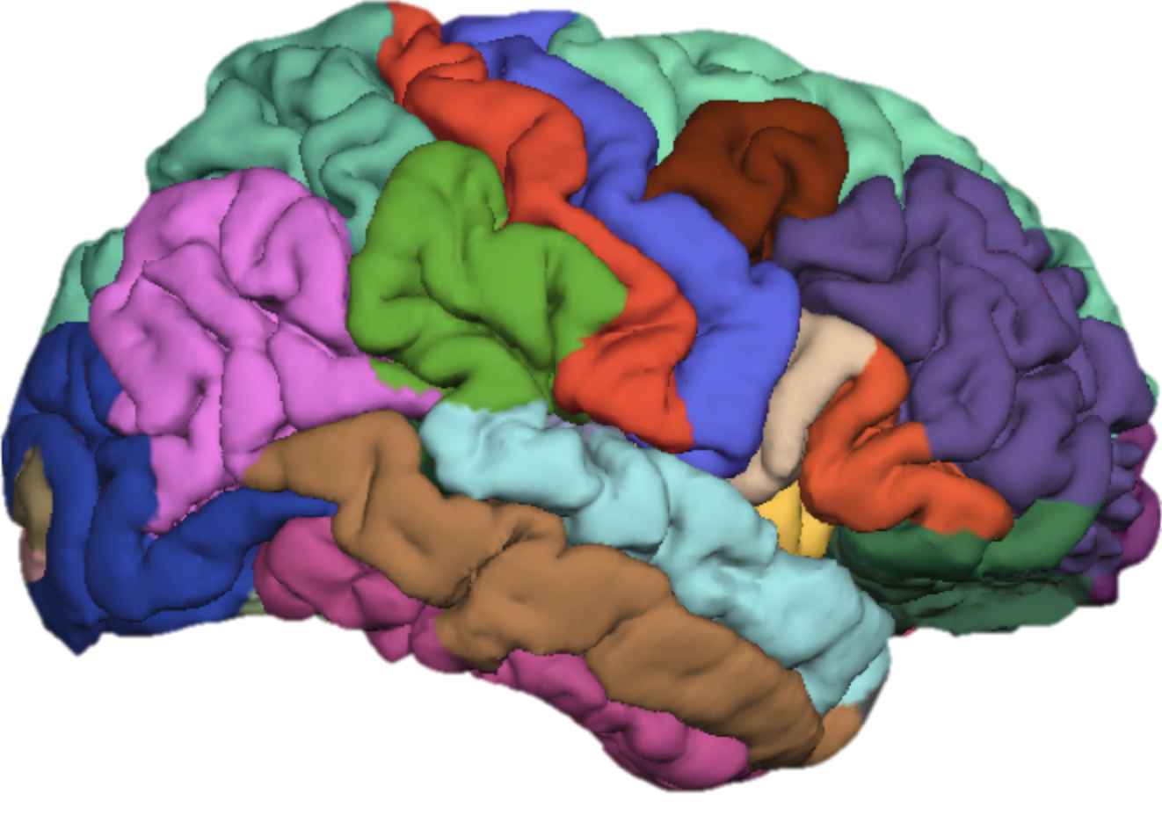
FreeSurfer Class 4: Parcellating the Cortex (autorecon3)
Cat Camacho
2/13/17
11:00am-12:30pm

Slide 2
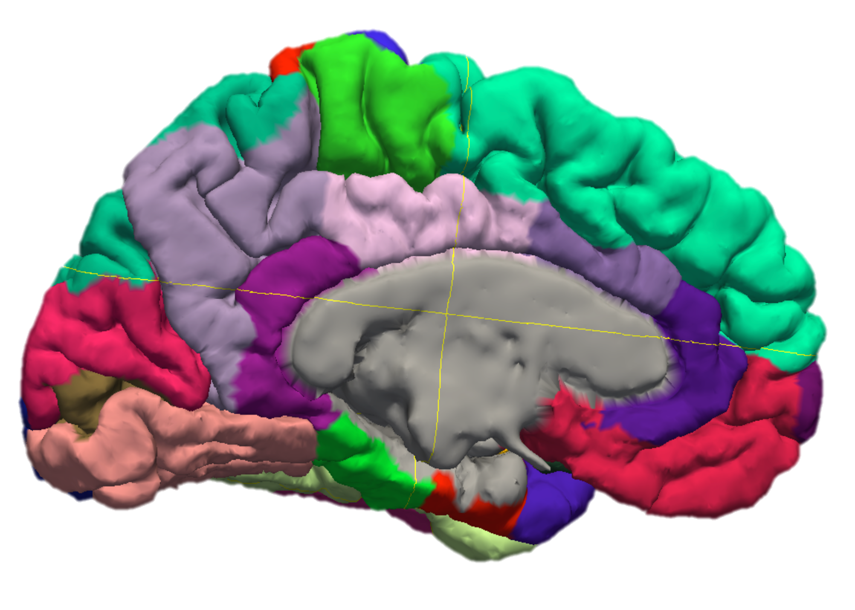
Goals for Today
Check in about suggested practice
ITK-Snap (just for fun)
FreeSurfer autorecon3:
DK atlas
Destrieux atlas
WM parc
Extracting data

Slide 3
Subject Folder Contents
mri
aparc+aseg.mgz: Desikan-Killany segmentation + aseg
aparc.a2009s+aseg.mgz: Destrieux segmentation + aseg
wmparc.mgz: Desikan-Killany segmentation + aseg + WM
label
lh.BA*.label/rh.BA*.label
lh.BA.annot/rh.BA.annot
stats
aseg.stats
lh.aparc.2009s.stats/rh.aparc.2009s.stats
lh.aparc.stats/rh.aparc.stats
lh.BA.stats/rh.BA.stats
wmparc.stats
Notes:
Pull up each volume in tkmedit

Slide 4
Autorecon3
1. Spherical Registration
2. Cortex Parcellation:
Desikan-Killany Atlas
3. Cortex Parcellation:
Destrieux Atlas
4. White Matter Parcellation
5. Generate Brodmann Area Labels

Slide 5
Running autorecon3
To run only autorecon3 on an existing subject (~3-6 hours):
T/CSH:
>> setenv SUBJECTS_DIR /home/catcam1/FS_Class/subjDir
>> recon-all -s Monica -autorecon3
BASH:
>> export SUBJECTS_DIR=/home/catcam1/FS_Class/subjDir
>> recon-all -s Monica -autorecon3

Slide 6
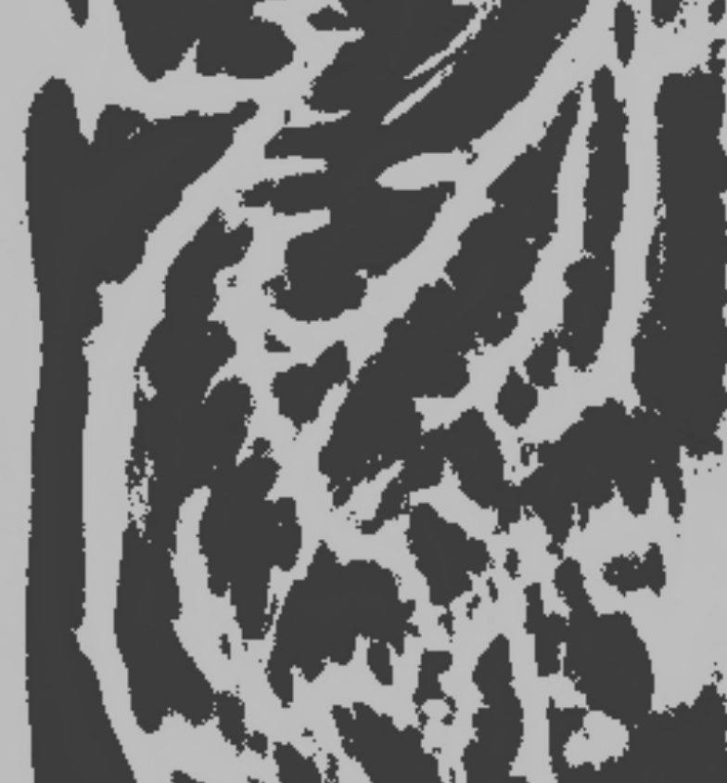
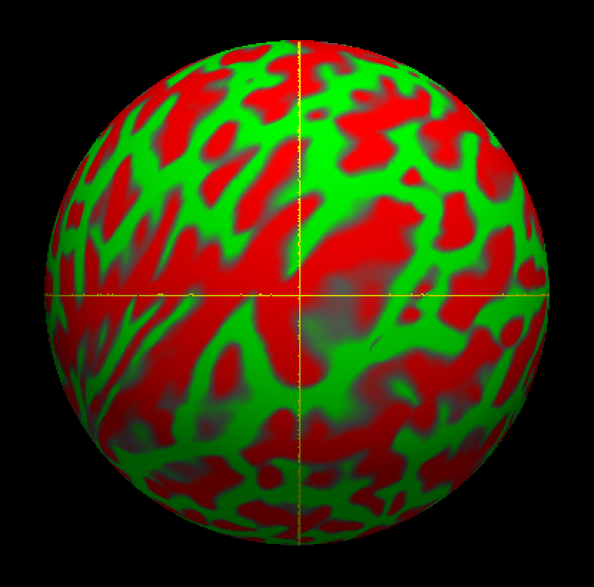
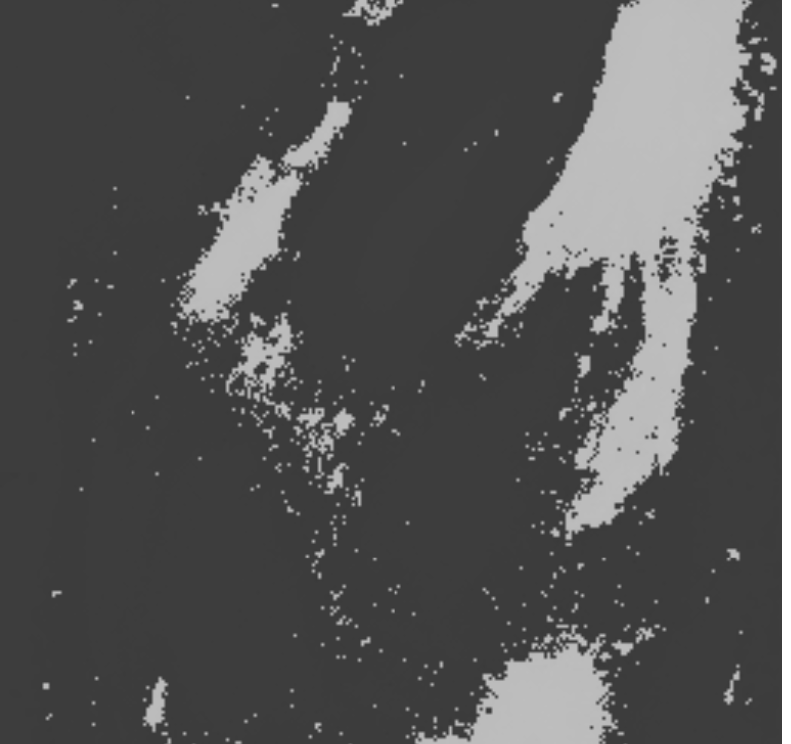
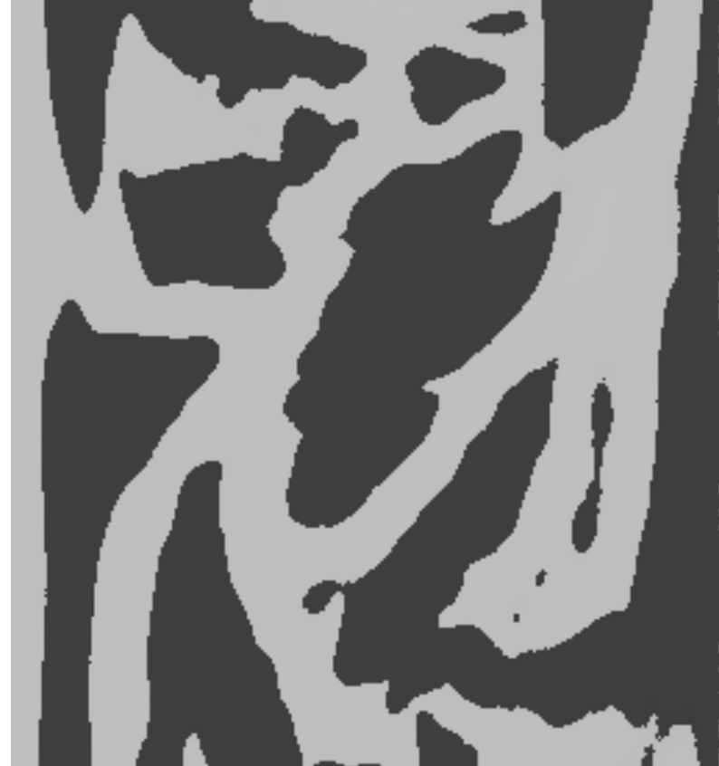
Spherical Inflation and Registration
Once surfaces from autorecon2 are set and gyri/sulci are identified, each hemisphere is inflated spherically
This step registers the white matter surface and the gyri/sulci curvature to the Buckner 40 atlas
Desikan, R. S., Ségonne, F., Fischl, B., Quinn, B. T., Dickerson, B. C., Blacker, D., … Killiany, R. J. (2006). An automated labeling system for subdividing the human cerebral cortex on MRI scans into gyral based regions of interest. NeuroImage, 31, 968–980. http://doi.org/10.1016/j.neuroimage.2006.01.021

Slide 7
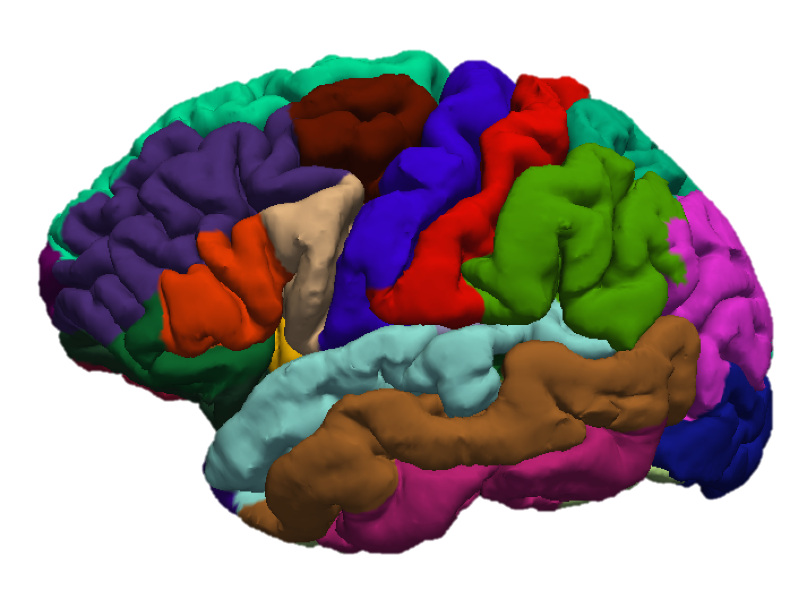
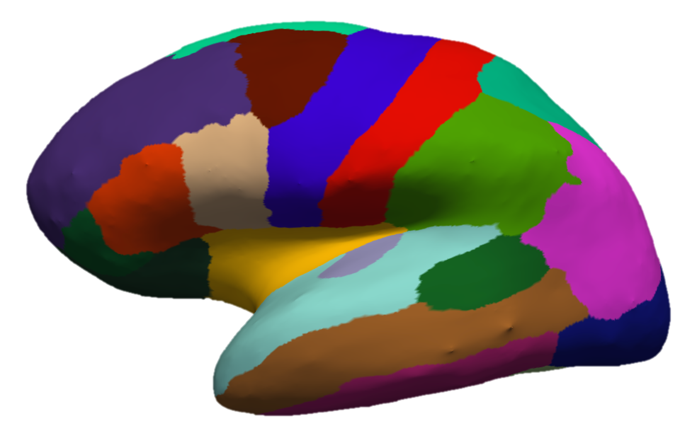
Cortical Parcellation: Desikan-Killany Atlas
Subdivides each hemisphere into 34 regions
Guidelines for delineating structures are detailed in Desikan et al. 2006
Read more here:
https://surfer.nmr.mgh.harvard.edu/fswiki/CorticalParcellation
Desikan, R. S., Ségonne, F., Fischl, B., Quinn, B. T., Dickerson, B. C., Blacker, D., … Killiany, R. J. (2006). An automated labeling system for subdividing the human cerebral cortex on MRI scans into gyral based regions of interest. NeuroImage, 31, 968–980. http://doi.org/10.1016/j.neuroimage.2006.01.021

Slide 8
Desikan-Killany Atlas Regions
Frontal
Superior Frontal
Rostral and Caudal Middle Frontal
Pars Opercularis, Pars Triangularis, and Pars Orbitalis
Lateral and Medial Orbitofrontal
Precentral
Paracentral
Frontal Pole
Temporal
Superior, Middle, and Inferior Temporal
Banks of the Superior Temporal Sulcus
Fusiform
Transverse Temporal
Entorhinal
Temporal Pole
Parahippocampal
Occipital
Lateral Occipital
Lingual
Cuneus
Pericalcarine
Parietal
Superior Parietal
Inferior Parietal
Supramarginal
Postcentral
Precuneus
Cingulate
Rostral Anterior (Frontal)
Caudal Anterior (Frontal)
Posterior (Parietal)
Isthmus (Parietal)

Slide 9
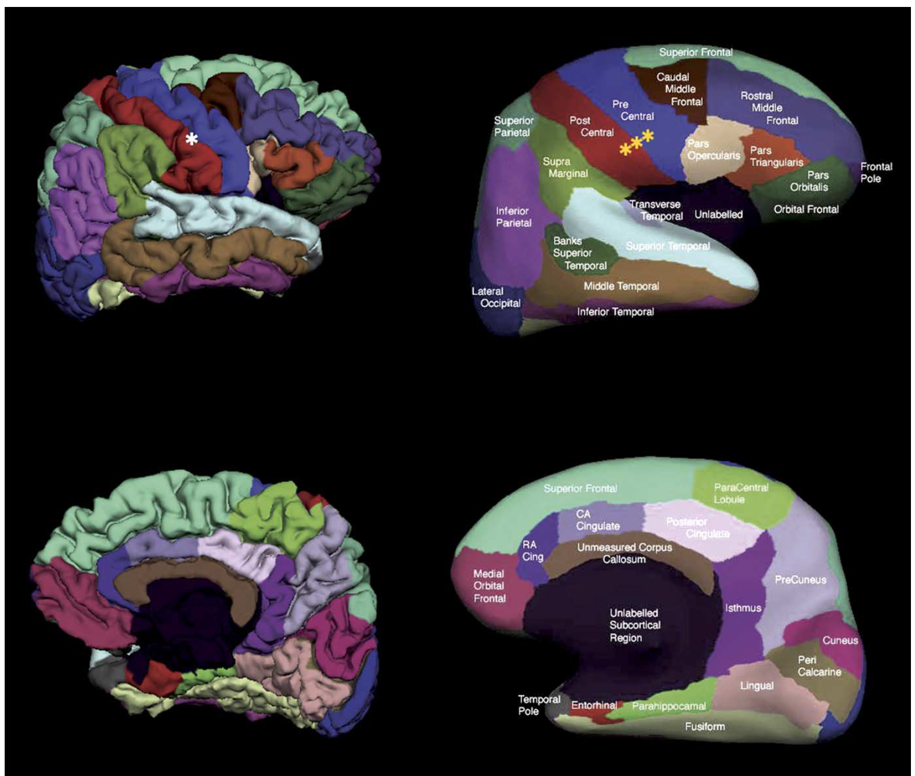
Desikan-Killany Automatic Labeling
Steps:
Spherical registration
Probabilistic initial labeling
Refine labeling by iteratively minimizing distance between label and gyral/sulcal pattern
(Step 3 is done with an energy function better described in Fischl et al., 1999)
Benefits:
Gyri define each region, but consistent sulcal boundary is defined
High consistency with manual tracing
Highly effective adaptation to each subject’s unique folding
Desikan, R. S., Ségonne, F., Fischl, B., Quinn, B. T., Dickerson, B. C., Blacker, D., … Killiany, R. J. (2006). An automated labeling system for subdividing the human cerebral cortex on MRI scans into gyral based regions of interest. NeuroImage, 31, 968–980. http://doi.org/10.1016/j.neuroimage.2006.01.021

Slide 10
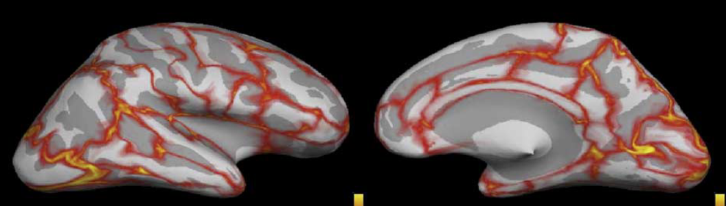
Desikan-Killany Automatic Labeling
Mean distance error map between automatic and manual labeling:
Key
Yellow = 1.0mm
Red = 0.5mm
Gray = 0.0mm
Desikan, R. S., Ségonne, F., Fischl, B., Quinn, B. T., Dickerson, B. C., Blacker, D., … Killiany, R. J. (2006). An automated labeling system for subdividing the human cerebral cortex on MRI scans into gyral based regions of interest. NeuroImage, 31, 968–980. http://doi.org/10.1016/j.neuroimage.2006.01.021

Slide 11
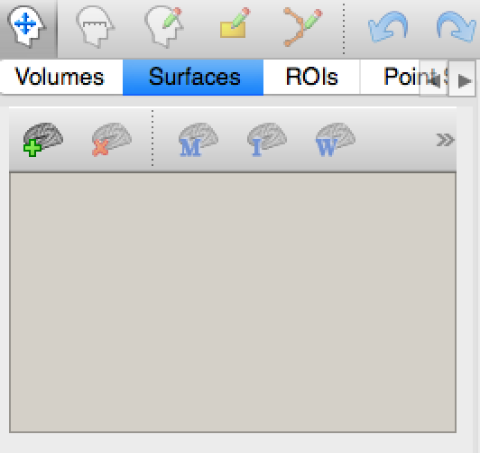
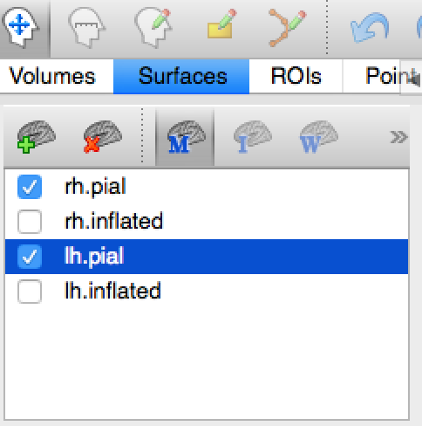
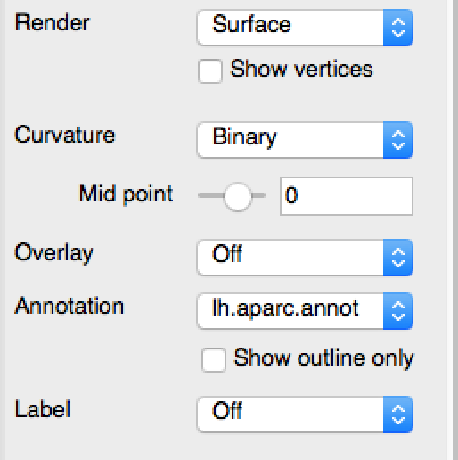
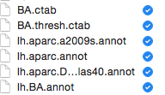
Loading DK Parcellation: freeview
Load *h.pial or *h.inflated surfaces
Load *h.aparc.annot onto the corresponding surface’s annotation
Note: The segmentation (aparc+aseg.mgz) can be viewed as a volume just like aseg.mgz

Slide 12
Loading DK Parcellation: scripted
Parcellation:
Segmentation:
*These commands are also in the checkDesikanSurf and checkDesikanSeg scripts in the class bin
>> freeview -viewport 3d -f $SUBJECTS_DIR/$sub/surf/lh.pial:annot=aparc.annot:name=pial_aparc \
$SUBJECTS_DIR/$sub/surf/rh.pial:annot=aparc.annot:name=pial_aparc
>> freeview -v $SUBJECTS_DIR/$sub/mri/brainmask.mgz \
-v $SUBJECTS_DIR/$sub/mri/aparc+aseg.mgz:colormap=lut

Slide 13
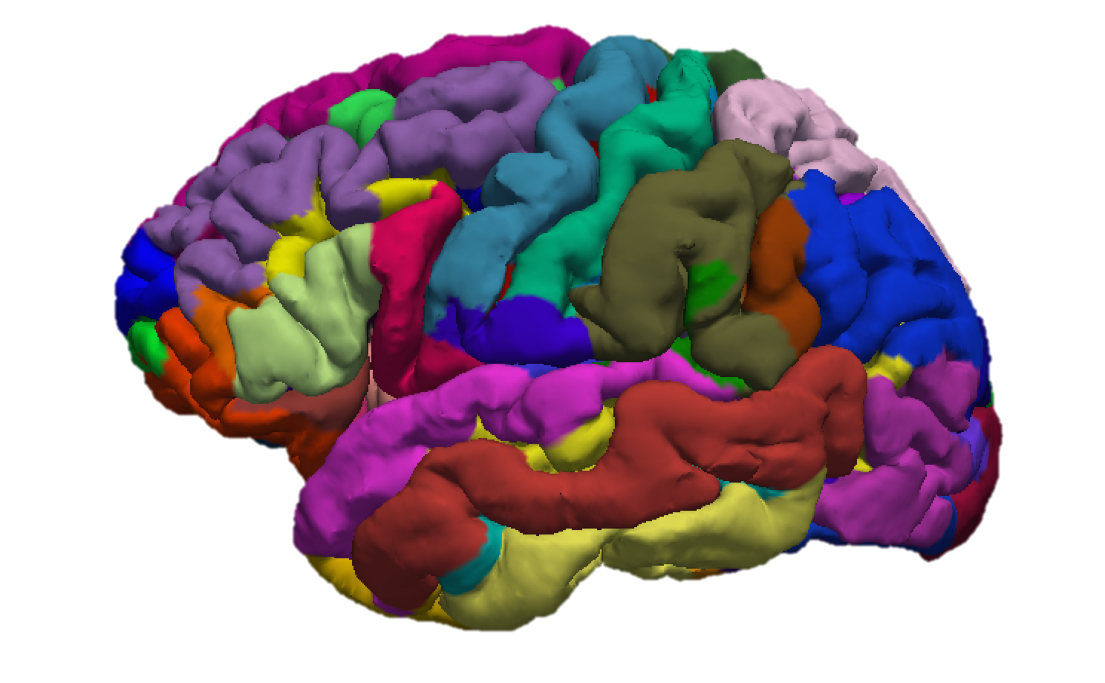
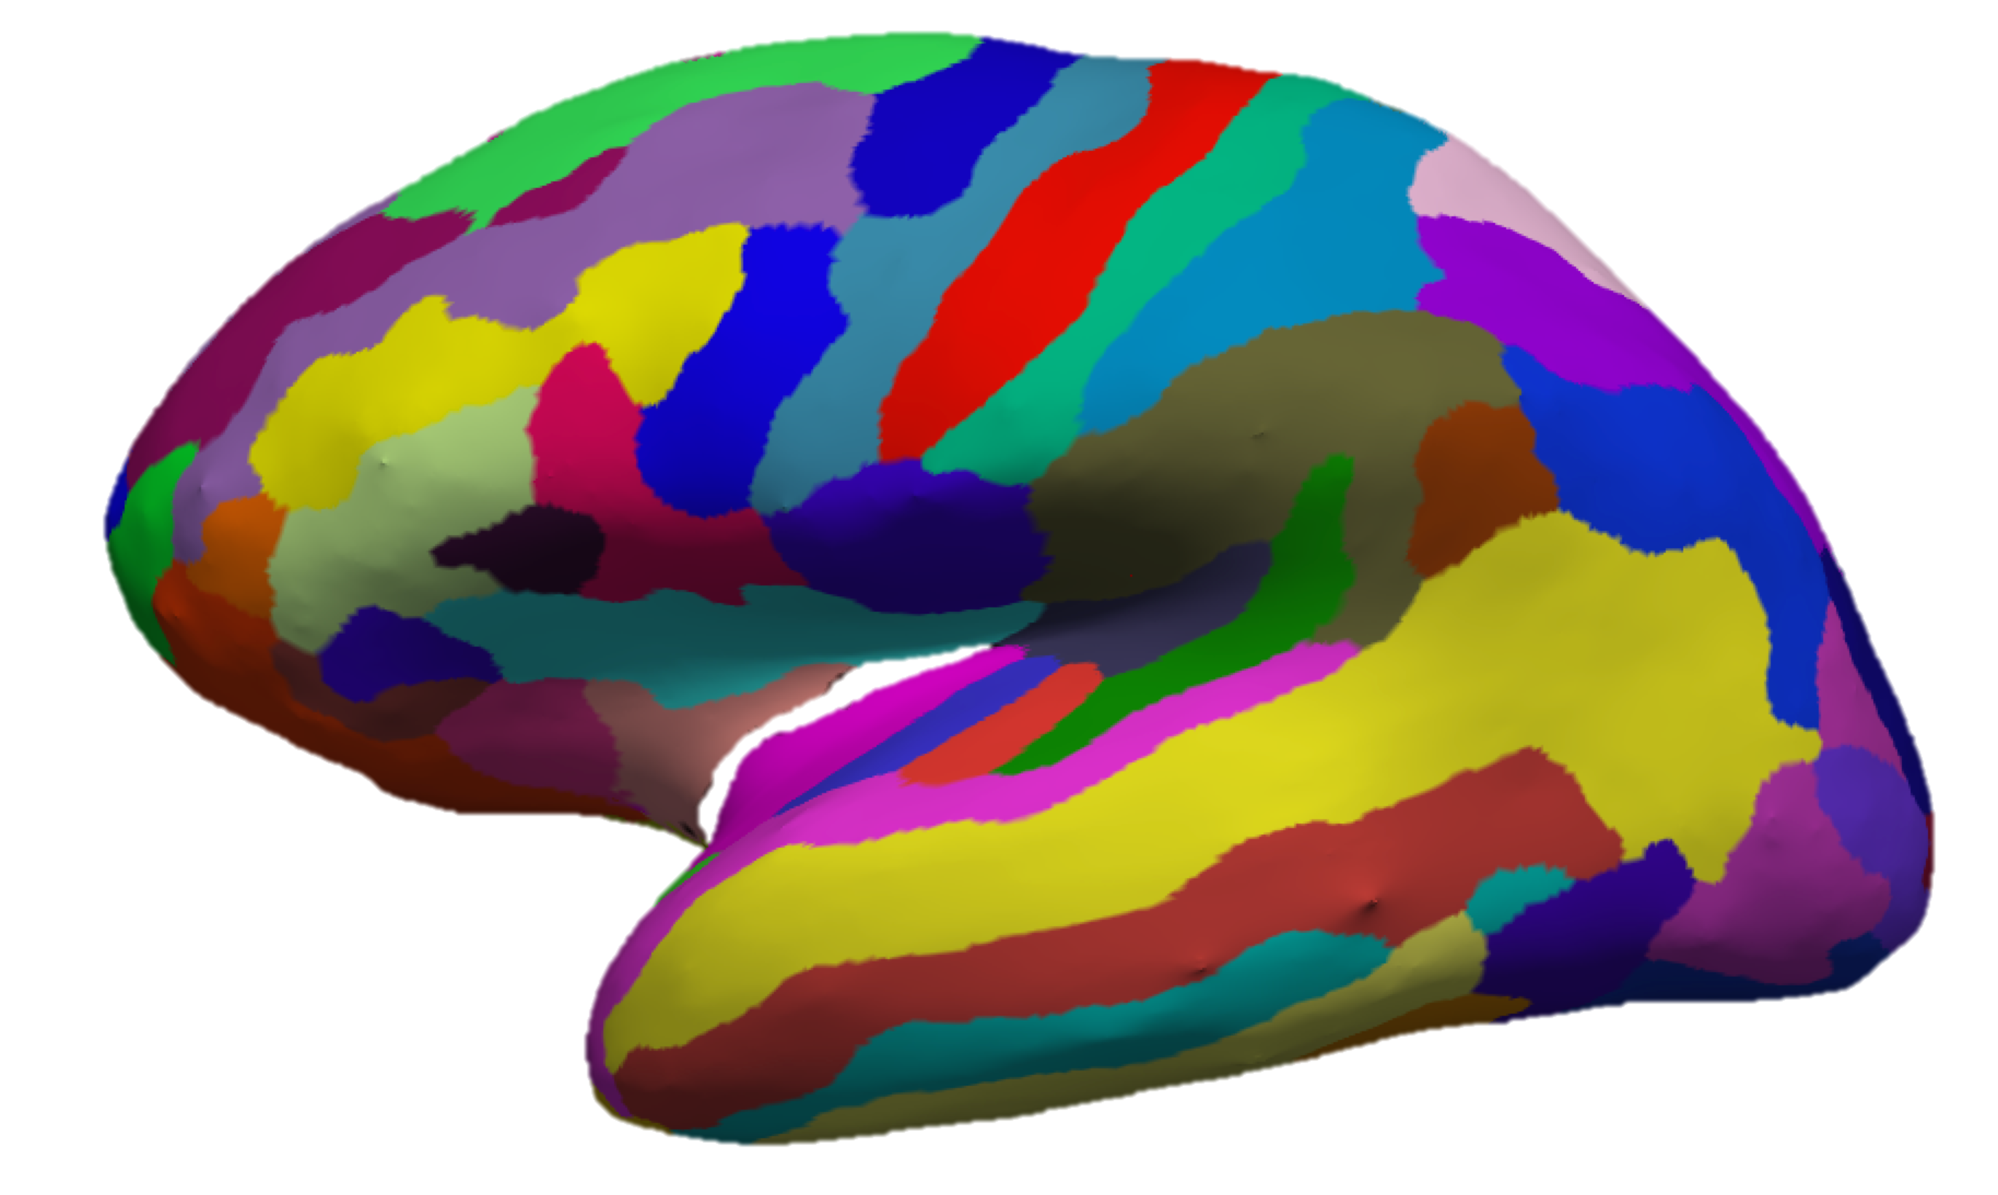
Cortical Parcellation: Destrieux Atlas
Includes 74 labels in each hemisphere (revised to ~77 in 2009)
Addresses a critical problem with cortical parcellation: gyrus boundaries are ambiguous.
Q: Where does the precentral gyrus end and the postcentral gyrus begin?
A: The bounds of the central sulcus
Destrieux, C., Fischl, B., Dale, A., & Halgren, E. (2010). Automatic parcellation of human cortical gyri and sulci using standard anatomical nomenclature. NeuroImage, 53(1), 1–15. http://doi.org/10.1016/j.neuroimage.2010.06.010

Slide 14
Destrieux Atlas Regions
G_cuneus
G_frontal_inf-Opercular_part
G_frontal_inf-Orbital_part
G_frontal_inf-Triangular_part
G_frontal_middle
G_frontal_superior
G_frontomarginal
G_insular_long
G_insular_short
G_and_S_occipital_inferior
G_occipital_middle
G_occipital_superior
G_occipit-temp_lat-Or_fusiform
G_occipit-temp_med-Lingual_part
G_occipit-temp_med-Parahippocampal_part
G_orbital
G_paracentral
G_parietal_inferior-Angular_part
G_parietal_inferior-Supramarginal_part
G_parietal_superior
G_postcentral
G_precentral
G_precuneus
G_rectus
G_subcallosal
G_subcentral
G_temporal_inferior
G_temporal_middle
G_temp_sup-G_temp_transv_and_interm_S
G_temp_sup-Lateral_aspect
G_temp_sup-Planum_polare
G_temp_sup-Planum_tempolare
G_and_S_transverse_frontopolar
Lat_Fissure-ant_sgt-ramus_horizontal
Lat_Fissure-ant_sgt-ramus_vertical
Lat_Fissure-post_sgt
Medial_wall
Pole_occipital
Pole_temporal
S_calcarine
S_central
S_central_insula
S_cingulate-Main_part_and_Intracingulate
S_cingulate-Marginalis_part
S_circular_insula_anterior
S_circular_insula_inferior
S_circular_insula_superior
S_collateral_transverse_ant
S_collateral_transverse_post
S_frontal_inferior
S_frontal_middle
S_frontal_superior
S_frontomarginal
S_intermedius_primus-Jensen
S_intraparietal-and_Parietal_transverse
S_occipital_anterior
S_occipital_middle_and_Lunatus
S_occipital_superior_and_transversalis
S_occipito-temporal_lateral
S_occipito-temporal_medial_and_S_Lingual
S_orbital-H_shapped
S_orbital_lateral
S_orbital_medial-Or_olfactory
S_paracentral
S_parieto_occipital
S_pericallosal
S_postcentral
S_precentral-Inferior-part
S_precentral-Superior-part
S_subcentral_ant
S_subcentral_post
S_suborbital
S_subparietal
S_supracingulate
S_temporal_inferior
S_temporal_superior
S_temporal_transverse
Destrieux, C., Fischl, B., Dale, A., & Halgren, E. (2010). Automatic parcellation of human cortical gyri and sulci using standard anatomical nomenclature. NeuroImage, 53(1), 1–15. http://doi.org/10.1016/j.neuroimage.2010.06.010

Slide 15
Loading the Destrieux Atlas
Freeview
Same instructions as with the DK atlas, but use *h.aparc.a2009s.annot instead of *h.aparc.annot
Scripted
Parcellation: Same as DK, but refer to aparc.a2009s.annot instead of aparc.annot
Segmentation: load aparc.a2009s+aseg.mgz instead of aparc+aseg.mgz
These are included in the class bin as checkDestrieuxSurf and checkDestrieuxSeg respectively

Slide 16
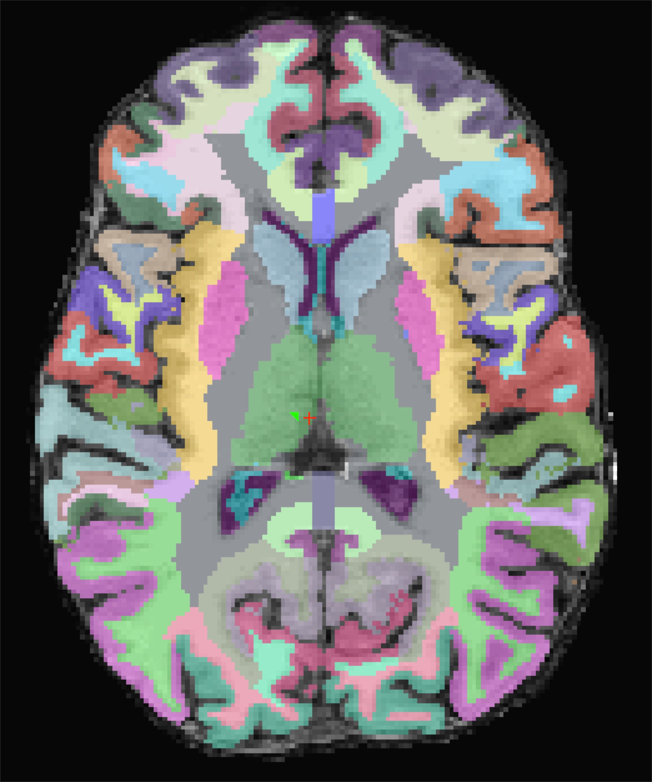
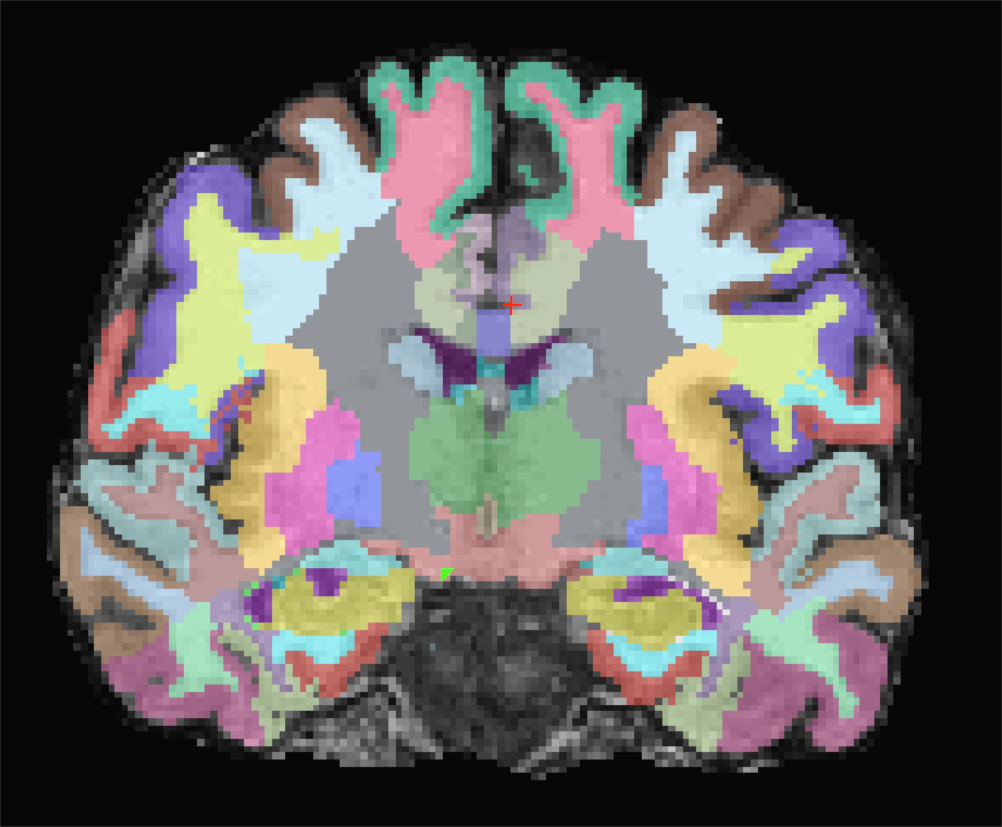
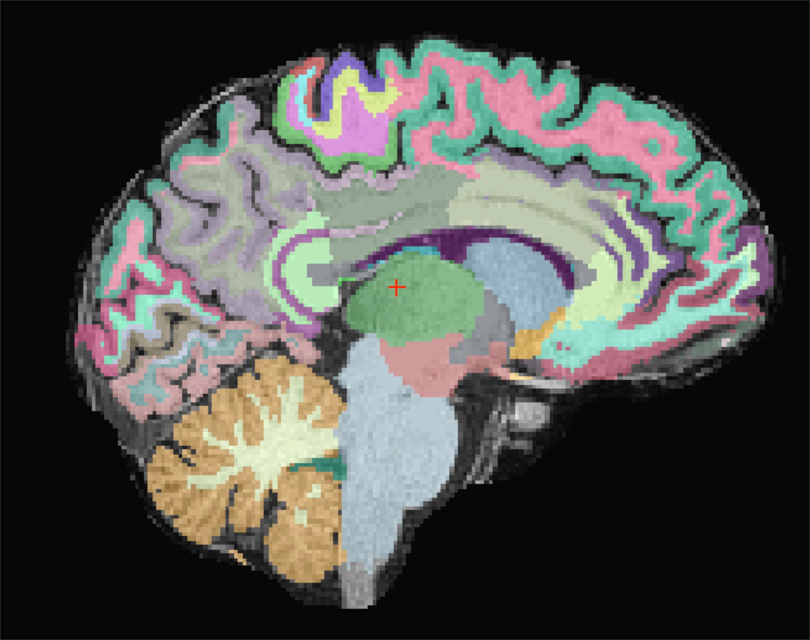
White Matter Parcellation
Atlas created by expanding DK atlas labeling out (expansion halted at 5mm).
The purpose is to measure the WM constrained within each associated gyrus.
White matter parcellation can be loaded as a volume: wmparc.mgz
Salat, D. H., Greve, D. N., Pacheco, J. L., Quinn, B. T., Helmer, K. G., Buckner, R. L., & Fischl, B. (2009). Regional white matter volume differences in nondemented aging and Alzheimer’s disease. NeuroImage, 44, 1247–1258. http://doi.org/10.1016/j.neuroimage.2008.10.030

Slide 17
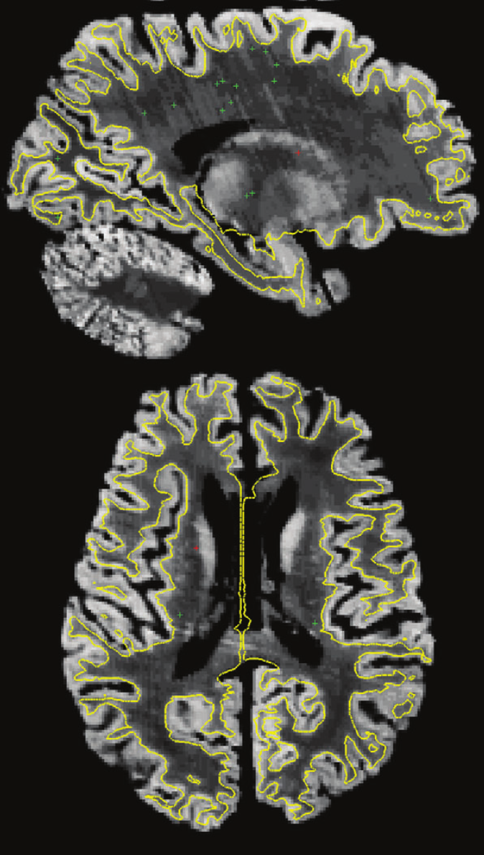
Brodmann Area Labeling
Developed based on 10 post-mortem brains:
Stained slices were aligned to corresponding MR images.
Results
11 regions were identified then surface analysis was conducted to test how consistent region prediction was.
Results vary by region (more on next slide) but folding patterns were robust predictors
Fischl, B., Rajendran, N., Busa, E., Augustinack, J., Hinds, O., Yeo, B. T. T., … Zilles, K. (2008). Cortical Folding Patterns and Predicting Cytoarchitecture. Cerebral Cortex August, 18, 1973–1980. http://doi.org/10.1093/cercor/bhm225

Slide 18
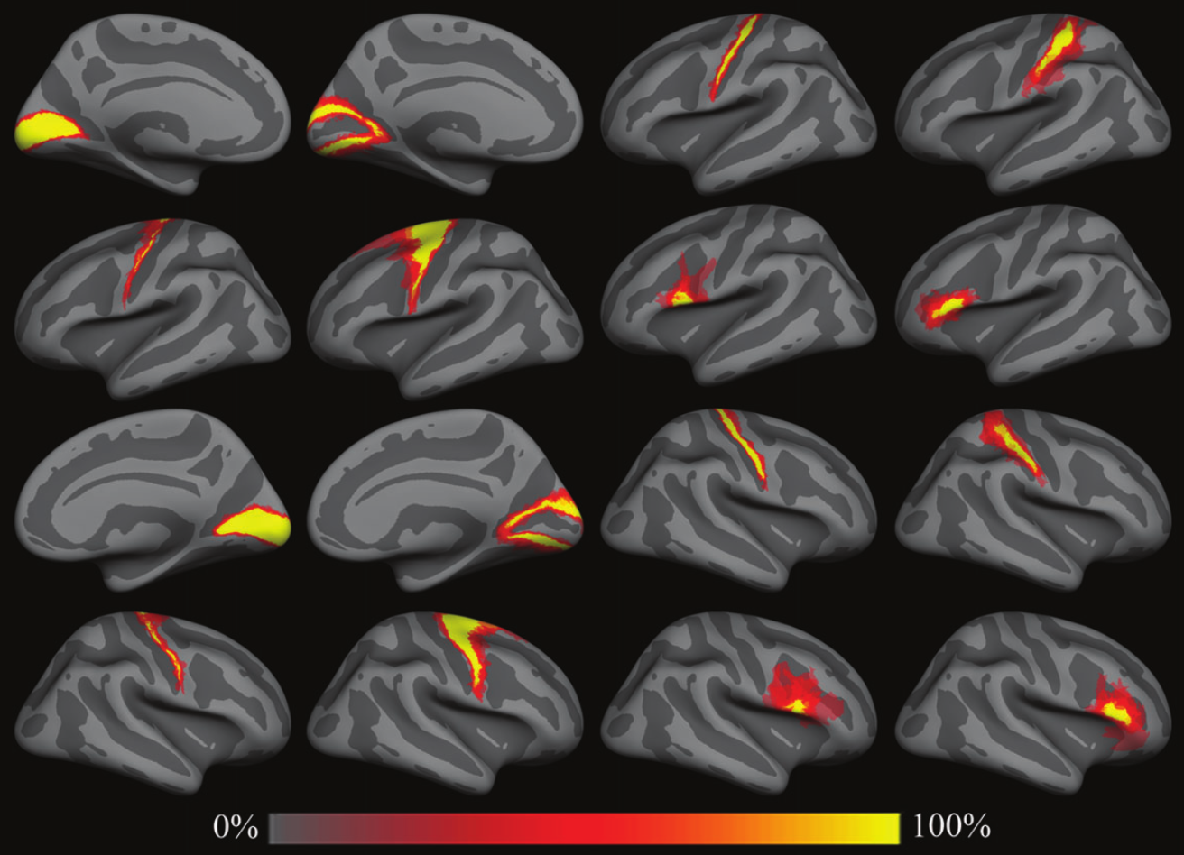
Brodmann Area Labeling
A | B | C | D
Regions:
BA 1 - somatosensory area
BA 2 - somatosensory area
BA 3a - somatosensory area
BA 3b - somatosensory area
BA 4a - primary motor area (anterior)
BA 4p - primary motor area (posterior)
BA 6 - pre-motor area
BA 44 - Broca's area (pars opercularis)
BA 45 - Broca's area (pars triangularis)
V1 (BA 17) - primary visual area
V2 (BA 18) - secondary visual area
V5/MT - visual area, middle temporal
Read more here:
https://surfer.nmr.mgh.harvard.edu/fswiki/BrodmannAreaMaps
1
2
3
4
Left Hemi
Right Hemi
 | A | B | C | D
1 | V1 | V2 | BA 4p | BA 2
2 | BA 4a | BA 6 | BA 44 | BA 45
3 | V1 | V2 | BA 4p | BA 2
4 | BA 4a | BA 6 | BA 44 | BA 45
Fischl, B., Rajendran, N., Busa, E., Augustinack, J., Hinds, O., Yeo, B. T. T., … Zilles, K. (2008). Cortical Folding Patterns and Predicting Cytoarchitecture. Cerebral Cortex August, 18, 1973–1980. http://doi.org/10.1093/cercor/bhm225

Slide 19
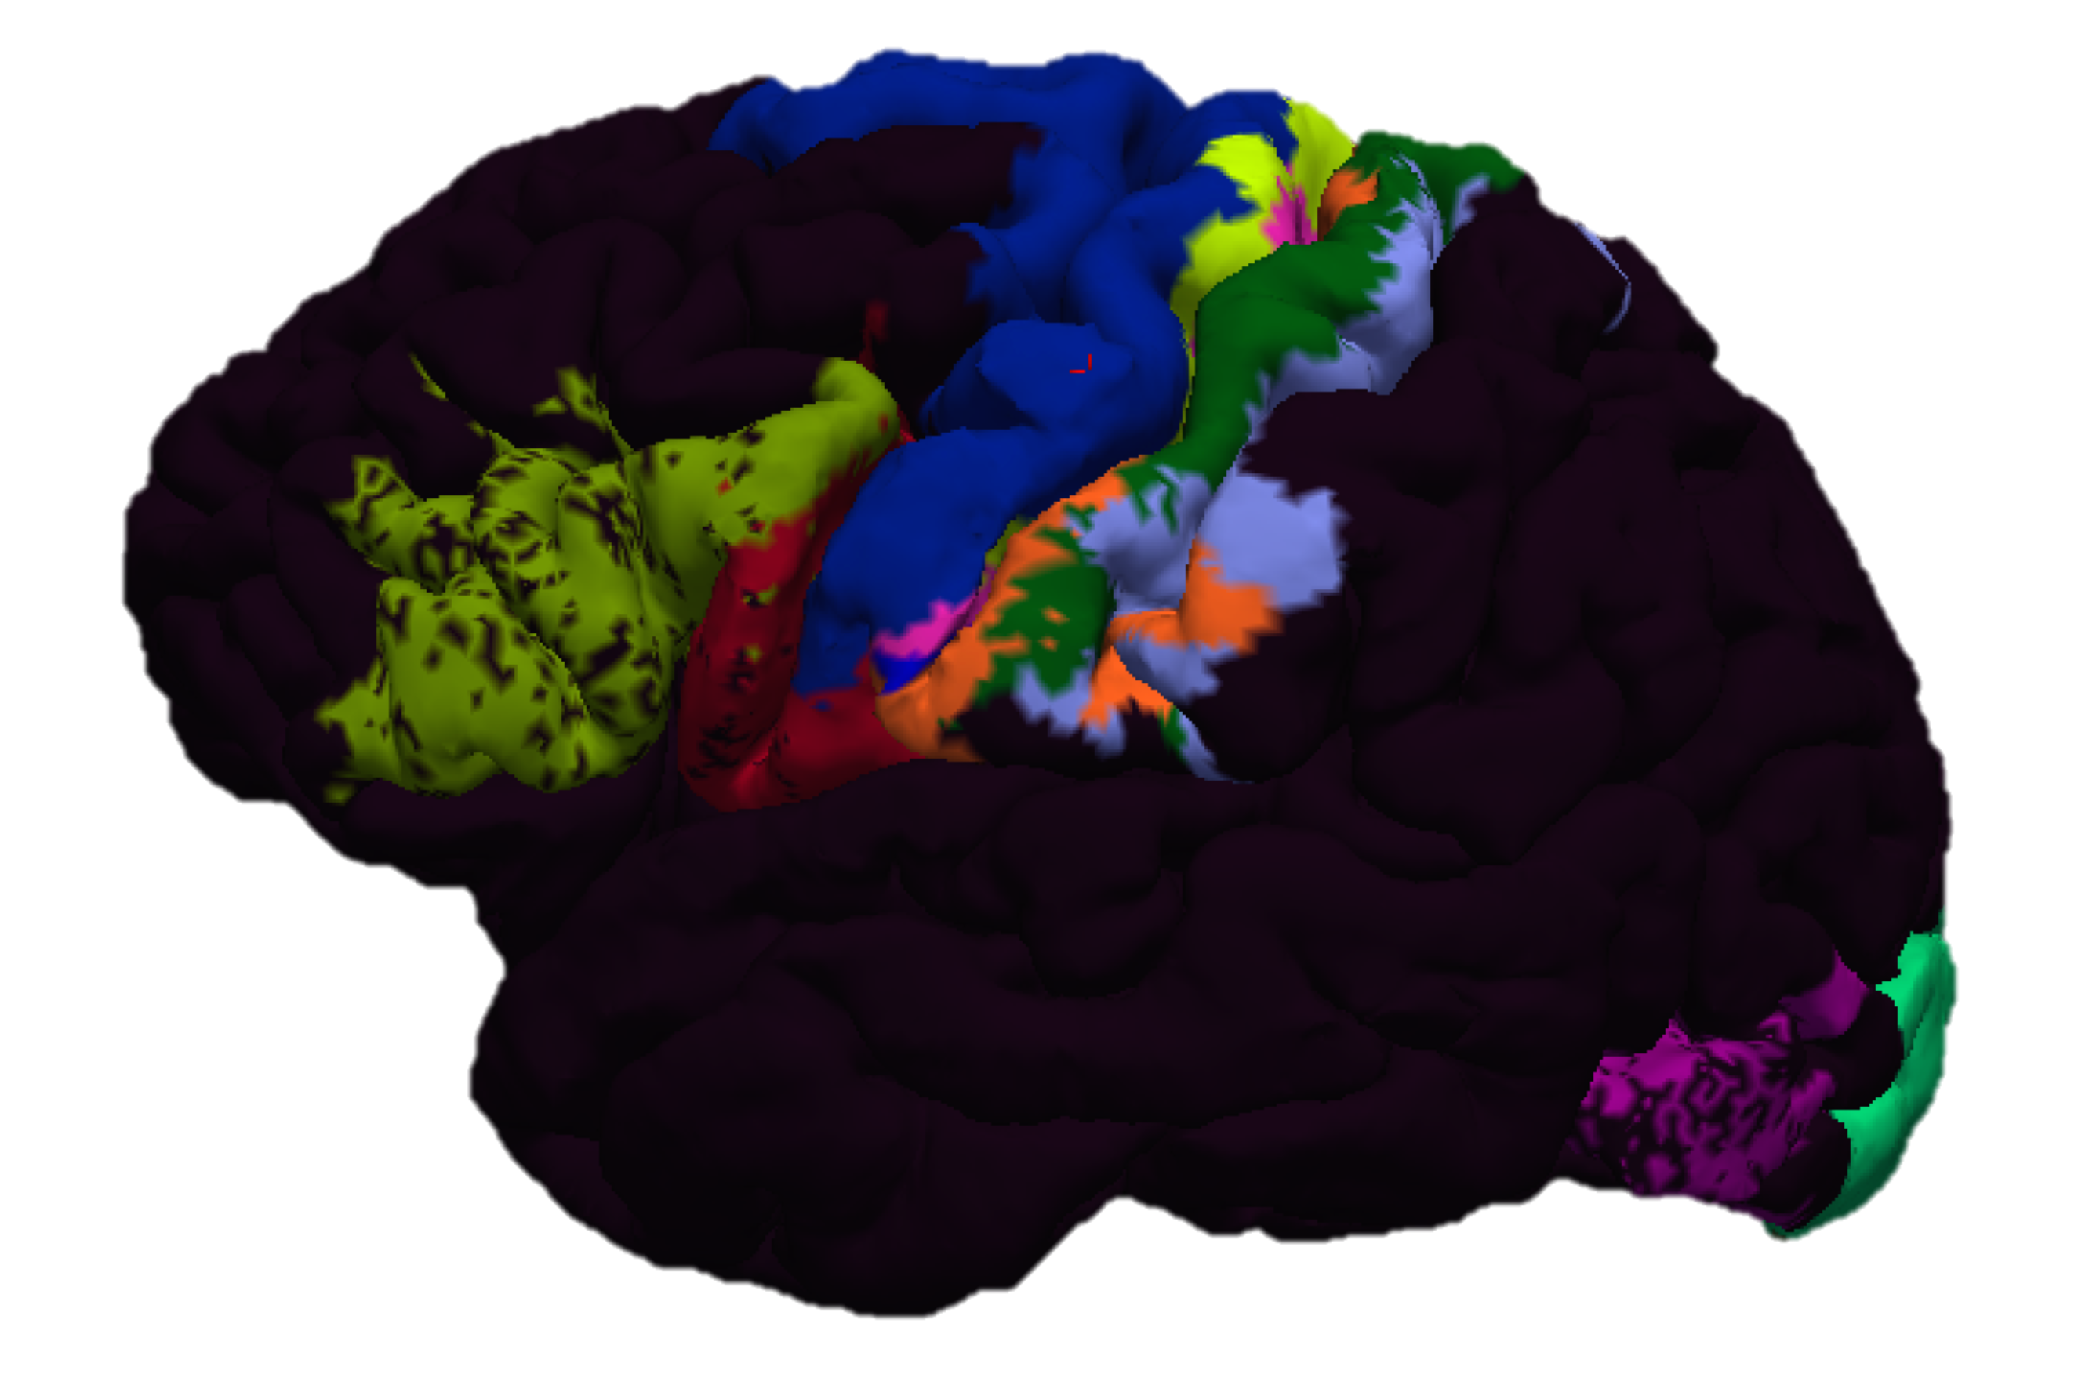
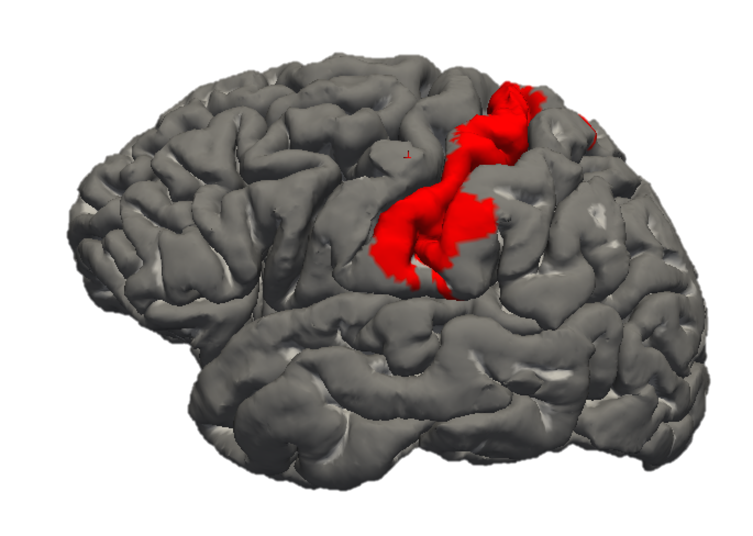
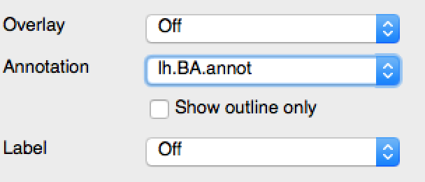
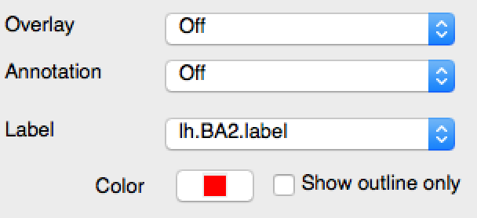
Loading BA labels
Load inflated/pial surface.
Load full annotation:
*h.BA.annot
Load inflated/pial surface.
Load individual label(s):
e.g. *h.BA1.label
e.g. *h.BA2.label

Slide 20
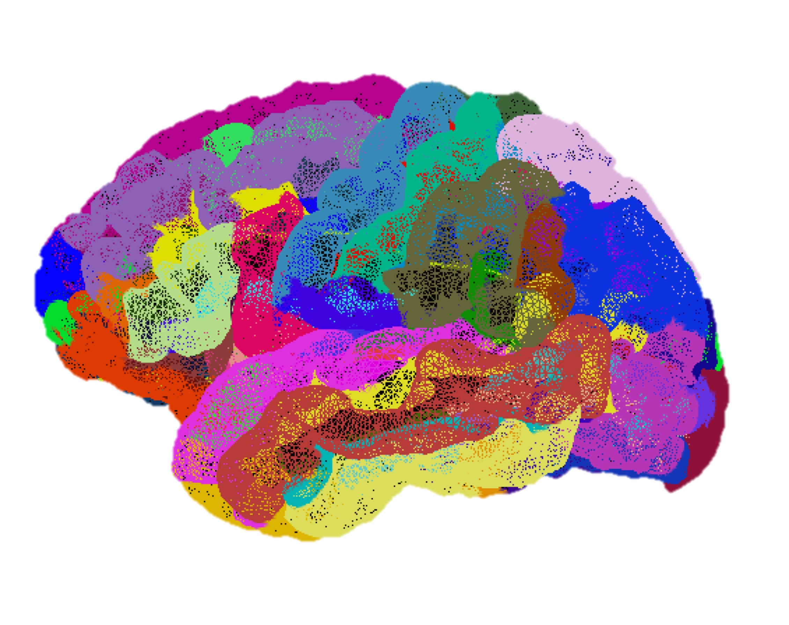
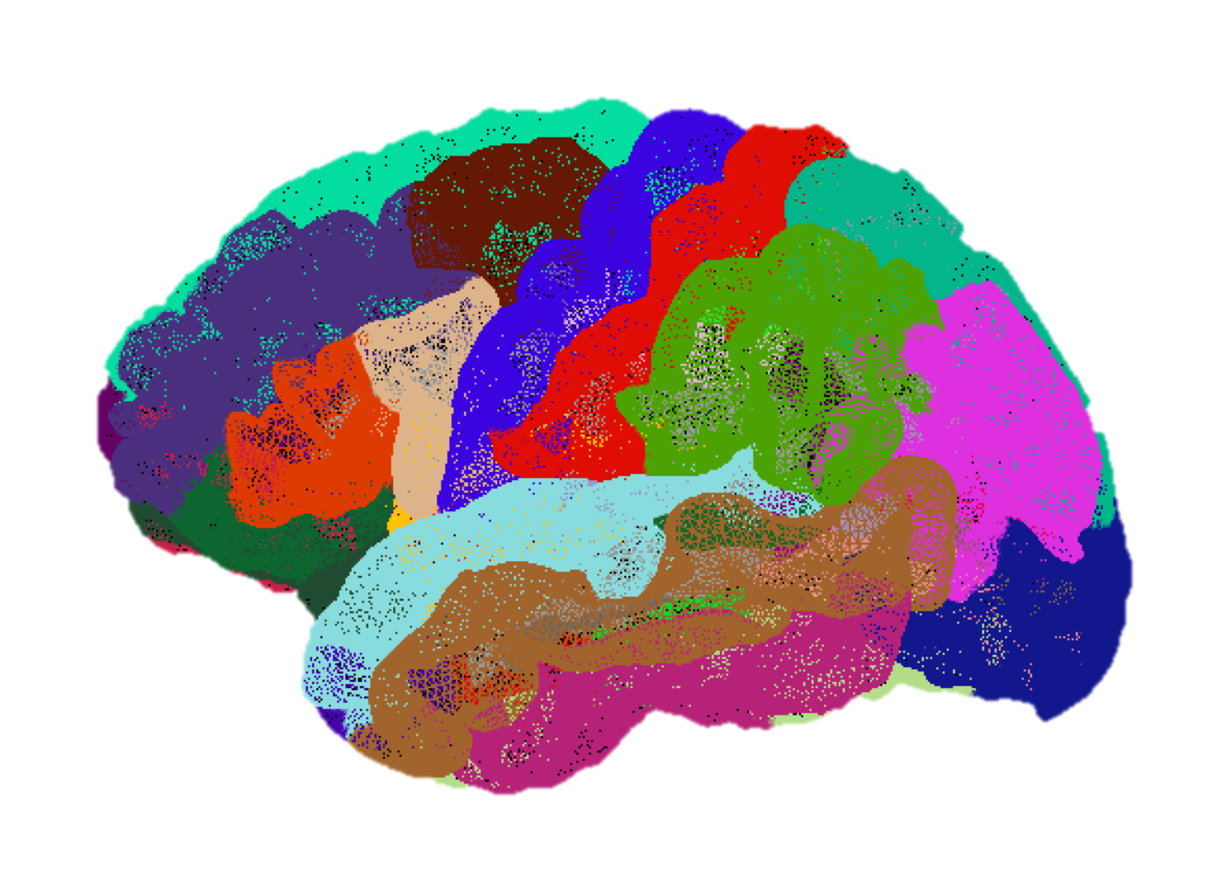
Extracting Stats
Measurements based on segmentation and parcellation are kept in the “stats” folder for each subject as text files
Each atlas-specific file contains measurements for:
Whole brain
Whole hemisphere
Region-specific

Slide 21
Extracting Stats
aseg.stats/wmparc.stats
*h.aparc.stats/*h.aparc.a2009s.stats
Whole brain
brain volume (mm³)
brain volume minus ventricles (mm³)
left/right hemisphere cortical volume (mm³)
left/right hemisphere white matter volume (mm³)
subcortical gray matter volume (mm³)
estimated total intracranial volume (mm³)
Region-specific
total number of voxels
volume (mm³)
normalized mean intensity
normalized intensity SD
normalized min/max
normalized intensity range
Whole hemisphere
Number of vertices
White matter surface area (mm²)
Mean cortical thickness (mm)
Region-specific
Number of vertices
Surface area (mm²)
Volume (mm³)
Mean cortical thickness (mm)
Cortical thickness SD (mm)
Mean curvature (mm⁻¹)
Gaussian curvature (mm⁻²)
Folding index
Curvature index

Slide 22
Scripting Data Extraction
Because *.stats are text files, it’s relatively easy to script extraction using your favorite language (bash, csh, python, matlab, etc.)
The extractingData folder contains matlab extraction scripts I’ve written (compatible with matlab 2015a or later)
pullFreeSurferCorticalDesikan.m
pullFreeSurferCorticalDestrieux.m
pullFreeSurferVolumes.m

Slide 23
MATLAB script Details
To Use
Modify the filepath variables at the top
Import a subjects list OR copy and paste a list into the variable “subs”
Type the name of the function in the matlab command window
Cortical extraction (pullFreeSurferCortical*.m)
Produces 4 CSVs for each hemisphere
Mean cortical thickness
Cortical thickness SD
Surface area
Whole hemisphere data
Creates a workspace datastruct for easy manipulation in MATLAB
Subcortical extraction (pullFreeSurferVolumes.m)
Produces 1 CSV with volumes in mm³
Saves a .mat file with the values organized in a datastruct for easy import into MATLAB

Slide 24
Recommended Practice
Run Monica and Meghan’s brain all the way through autorecon3 (if you haven’t already)
Open Monica or Meghan’s cortical parcellation in freeview
Extract stats for both brains

